Slide 1
Data Mining and Data Warehousing
Introduction

Slide 2
Introduction
1.1. Data Mining Origin
1.2. Data Mining & Data Warehousing basics

Slide 3
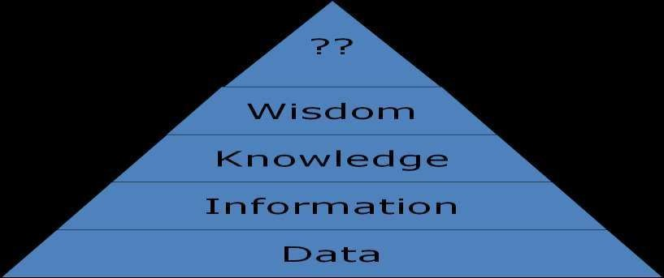
What is Data?
– A representation of facts, concepts, or instructions in a formal manner suitable for communication, interpretation, or processing by human beings or by computers.
3

Slide 4
Origin of Data mining
The steady and amazing progress of computer hardware technology in the past three decades has led to large supplies of powerful and affordable computers, data collection equipment, and storage media.
This technology provides a great boost to the database and information industry, and makes a huge number of databases and information re-positories available.
This availability of huge data repositories creates a Data explosion problem (data rich knowledge poor situation).
4

Slide 5
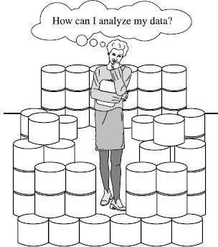
Contd..
We are drowning in data, but starving for knowledge!
So, Powerful and versatile tools are badly needed to automatically uncover valuable information from tremendous amounts of data and to transform such data into organized knowledge.
Necessity is the Mother of invention! -plato
This necessity has led to the birth of data mining.
5

Slide 6
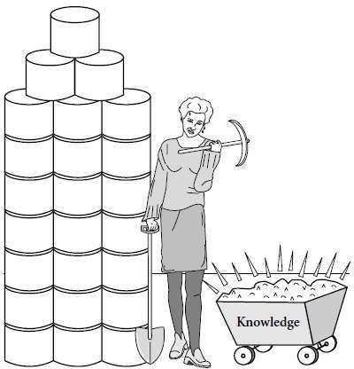

What is Data Mining?
Extraction of interesting (non-trivial, implicit, previously unknown and potentially
useful) patterns or knowledge from huge amount of data.
1

Slide 7
Contd...
Data mining: a misnomer?
  Scenario: Remember that the mining of gold from the rocks or sand is
referred to as gold mining rather than rock or sand mining.
Thus, data mining should have been more appropriately named as “knowledge mining” which emphasis on mining knowledge from large amounts of data.
But, which is unfortunately somewhat long so, named “data mining”
The overall goal of the data mining process is to extract pattern from a data set and transform it into an understandable
structure for further use.
7

Slide 8
Contd..
Alternative names for data mining:
  Knowledge discovery(mining) in databases (KDD)
  knowledge extraction
  data/pattern analysis
  data archeology
  data dredging
  information harvesting
  business intelligence, etc.
8

Slide 9
Contd..
The key properties of data mining are:
  Automatic discovery of patterns
    E.g., Market basket analysis.
  Prediction of likely outcomes
    E.g., weather forecasting
  Creation of actionable information
    E.g., Police investigation
  Focus on large datasets and databases
9

Slide 10

Data mining is not
Brute-force crunching of bulk data.
“Blind” application of algorithms.
Going to find non-existential relationships.
Presenting data in different ways
Queries to the database are not DM.
A magic that will turn your data into gold.
18

Slide 11
Contd..
Data Mining: Confluence of Multiple Disciplines :
Database Technology
Statistics
Machine Learning
Visualization
Data Mining
Pattern Recognition
Other Disciplines
Algorithm

Slide 12
Why Data Mining?—Potential Applications
Data analysis and decision support
  Market analysis and management
    Market basket analysis, sale techniques, customer feedback on items (Opinion Mining)
  Risk analysis and management
    Forecasting, decision support system
  Fraud detection and detection of unusual patterns (outliers)

Slide 13
Why Data Mining?—Potential Applications
OtherApplications
  Text mining (news group, email, documents) and Web mining
  Stream data mining (mining from continuous / rapid data
    Eg Telephone communication pattern, Web Searching, Sensor data
  Bioinformatics and bio-data analysis

Slide 14
Data Mining: On What Kinds of Data?
As a general technology, data mining can be applied to any kind of data as long as the data are meaningful for a target application.
Database-oriented data sets and applications
  Relational database, data warehouse, transactional database

Slide 15
Contd..
Advanced data sets and advanced applications
  Data streams and sensor data
  Time-series data
  graphs, social networks and multi-linked data
  Heterogeneous databases and legacy databases
  Spatial data and spatiotemporal data
  Multimedia database
  Text databases
  The World-Wide Web

Slide 16
Knowledge Discovery (KDD) Process..
Simply stated, data mining refers to extracting or “mining” knowledge from large amounts of data stored in databases, data warehouses, or other information repositories.
Many people treat data mining as a synonym for another popularly used term, Knowledge Discovery from Data, or KDD.
Alternatively, others view data mining as simply an essential step in the process of knowledge discovery.
Knowledge discovery consists of an iterative sequence of the following steps:
16

Slide 17
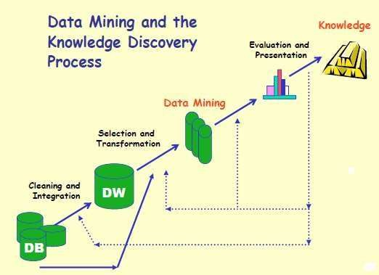
Contd..
Figure: Knowledge Discovery Process (Stages of KDD)
17

Slide 18
Contd..
Data cleaning :
  It removes noise and inconsistent data
Data integration:
  This combines data from multiple data sources
Data selection:
  Data relevant to the analysis task are retrieved from the database
Data transformation:
  Data are transformed or consolidated into forms appropriate for mining by performing summary or aggregation operations.
18

Slide 19
Contd..
Data mining:
  an essential process where intelligent methods are applied in order to extract data patterns
Pattern evaluation:
  Identifies the truly interesting patterns representing knowledge based on some interestingness measures.
Knowledge presentation:
  Knowledge representation techniques are used to present the mined knowledge to the user.
19

Slide 20
Contd..
According to this view, data mining is only one step in the knowledge discovery process.
However, in industry, in media, and in the database research milieu, the term data mining is becoming more popular than the longer term of knowledge discovery from data.
Therefore, we choose to use the term data mining.
Based on this view, the architecture of a typical data mining system is described in the following slides
20

Slide 21
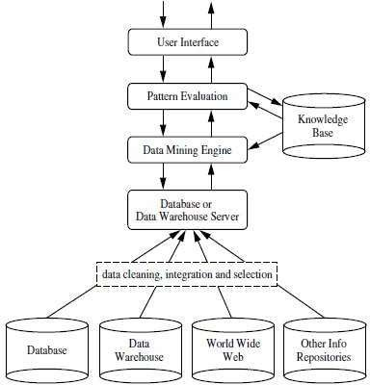
Architecture of Data Mining System
A typical data mining system may have the following majorcomponents.
Figure: Architecture of Data Mining System
21

Slide 22
Contd..
Database, Data Warehouse, World Wide Web, or Other Information
Repository:
  This is one or a set of databases, data warehouses, spreadsheets, or other kinds of information repositories.
  Data cleaning and data integration techniques may be performed on the data.
22

Slide 23
Contd..
Database or Data Warehouse Server:
– The database or data warehouse server is responsible for fetching the relevant data, based on the user’s data mining request.
23

Slide 24
Contd..
Knowledge Base:
  This is the domain knowledge that is used to guide the search or evaluate the interestingness of resulting patterns. It is simply stored in the form of set of rules.
  Such knowledge can include concept hierarchies, used to organize attributes or attribute values into different levels of abstraction.
24

Slide 25
Contd..
Data Mining Engine:
– This is essential to the data mining system and ideally consists of a set of functional modules for tasks such as association and correlation analysis, classification, prediction, cluster analysis, outlier analysis and etc.
25

Slide 26
Contd..
Pattern Evaluation Module:
  This component typically employs interestingness measures and interacts with the data mining modules so as to focus the searchtoward interesting patterns.
  It may use interestingness thresholds to filter out discovered patterns.
26

Slide 27
Contd..
User interface:
  This module communicates between users and the data mining system, allowing the user to interact with the system by specifying a data mining query or task.
  In addition, this component allows the user to browse database and data warehouse schemas or data structures, evaluate mined patterns, and visualize the patterns in
different forms.
27

Slide 28
What is a Data Warehouse?
A warehouse in general terms is a historic repository of information collected from multiple sources, stored under a unified schema, and that usually resides at a single site.
Data Warehouses are constructed via a process of
  DATACLEANING,
  DATAINTEGRATION,
  DATATRANSFORMATION,
  DATA LOADING, and
  PERIODIC DATAREFRESHING.
A data warehouse stores historical data of an organization so that they can analyze their performance over the past time (days, weeks, months or years) and plan for the future.
28

Slide 29
Contd……
The popular definition of the data warehouse is given by WH Inmon:
  “A data warehouse is a subject-oriented, integrated, time-variant, and nonvolatile collection of data in support of management’s decision- making process.”
Data warehousing:
The process of constructing and using data warehouses.
Is the process of extracting & transferring operational data into informational data & loading it into a central data store (warehouse)
37

Slide 30
Data Warehouse—Integrated
Constructed by integrating multiple, heterogeneous data sources
– relational databases, flat files, on-line transaction records
Data cleaning and data integration techniques are applied.
– Ensure consistency in naming conventions, encoding structures, attribute measures, etc. among different data sources
Sales
system
Payroll system
Customer
data
Purchasing
system
E.g., Hotel price: currency, tax, etc.

Slide 31
Data Warehouse—Subject-Oriented
Organized around major subjects, such as customer, product, sales.
Focusing on the modeling and analysis of data for decision makers, not on daily operations or transaction processing.
Sales system
Employee data
Payroll system
Customer data
Provide a simple and concise view around particular subject issues by excluding data that are not useful in the decision support process.
Vendor
data
Purchasing
system
Operational data DW

Slide 32
Data Warehouse—Time Variant
The time horizon for the data warehouse is significantly longer than that of operational systems.
  Operational database: current value data.
  Data warehouse data: provide information from a historical perspective (e.g., past 5-10 years)
40

Slide 33
Data Warehouse—Non-Volatile
A physically separate store of data
transformed from the operational environment.
DBMS
DW
Operational occur in environment.
update of data does not the data warehouse
create
access
update
Sales system
delete
Customer
data
Does not require transaction processing, recovery, and concurrency control mechanisms
Requires only two operations in data accessing:
  initial loading of data and access of
insert
load
data.
41

Slide 34
Data Warehouse Usage
Three kinds of data warehouse applications
  Information processing
    supports querying, basic statistical analysis, and reporting
using tables, charts and graphs.

Slide 35
Contd..
Analytical processing
  multidimensional analysis of data warehouse data
  supports basic OLAP operations(drill-down, roll-up, slice-dice, drilling, pivoting, which allows the user to view the data at differing degree of
summarization.
Data mining
  knowledge discovery from hidden patterns
  supports associations, constructing analytical models, performing
classification and prediction, and presenting the mining results using visualization tools.

Slide 36







General Architecture
Data acquisition
OLAP
Server
Data extraction
External
Sources
OLAP
queries/ reports
Data Integration Component
Query
and Data Analysis Component
Data Warehous e
data
mining
Metadata
Internal
Sources
Monitoring
Administration
Construction &

Slide 37
3 main phases
Data acquisition:
  relevant data collection
  Recovering: transformation into the data warehouse model from existing models
  Loading: cleaning and loading in the DataWarehouse.
Storage
Data extraction
  Tool examples: Query/report, SQL, multidimensional analysis (OLAP tools), data mining
Maintenance(Optional)

Slide 38
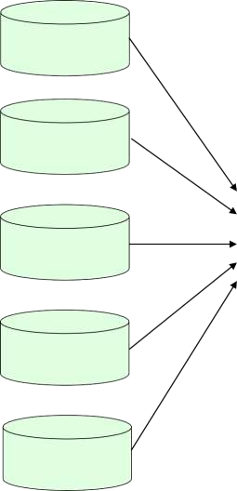

THE USE OF ADATA WAREHOUSE
INVENTORY DATABASE
STEP 1: Load the Data Warehouse
PERSONNEL
DATABASE
STEP 2: Question the DataWarehouse
DATA WAREHOUSE
NEWCASTLE SALES DB
LONDON
SALES DB
STEP 3: Do something with what you learn from the Data Warehouse
DECISIONS
andACTIONS!
GLASGOW
SALES DB

Slide 39
Benefits of Data Warehousing
Queries do not impact Operational systems
Provides quick response to queries for reporting
Enables Subject Area Orientation
Integrates data from multiple, diverse sources
Enables multiple interpretations of same data by different users or groups
Provides thorough analysis of data over a period of time
Accuracy of Operational systems can be checked
Provides analysis capabilities to decision makers

Slide 40
Increase customer profitability
Cost effective decision making
Manage customer and business partner relationships
Manage risk, assets and liabilities
Integrate inventory, operations and manufacturing
Reduction in time to locate, access, and
analyze
information (Link multiple locations and geographies)
Identify developing trends and reduce time to market
Strategic advantage over competitors

Slide 41
Potential high returns on investment
Competitive advantage
Increased productivity of corporate decision-makers
Provide reliable, High performance access
Consistent view of Data: Same query, same data. All users should be warned if data load has not come in.
Quality of data is a driver for business re-engineering.

Slide 42
Applications of Data Mining
Data mining is an interdisciplinary field with wide and diverse applications
  There exist nontrivial gaps between data mining principles and
domain-specific applications
Some application domains
  Financial data analysis
  Retail industry
  Telecommunication industry
  Biological data analysis

Slide 43
Data Mining for Financial Data Analysis
Financial data collected in banks and financial institutions are often relatively complete, reliable, and of high quality
Design and construction of data warehouses for multidimensional data analysis and data mining
  View the debt and revenue changes by month, by region, by sector, and by other factors
  Access statistical information such as max, min, total, average, trend, etc.
Loan payment prediction/consumer credit policy analysis
  feature selection and attribute relevanceranking
  Loan payment performance
  Consumer credit rating

Slide 44
Classification and clustering of customers for targeted marketing
  multidimensional segmentation by nearest-neighbor, classification, decision trees, etc. to identify customer groups or associate a new customer to an appropriate customer group
Detection of money laundering and other financial crimes
  integration of from multiple DBs (e.g., bank transactions, federal/state crime history DBs)
  Tools: data visualization, linkage analysis, classification, clustering tools, outlier analysis, and sequential pattern analysis tools (find unusual access sequences)

Slide 45
Data Mining for Retail Industry
Retail industry: huge amounts of data on sales, customer shopping history, etc.
Applications of retail data mining
  Identify customer buying behaviors
  Discover customer shopping patterns and trends
  Improve the quality of customer service
  Achieve better customer retention and satisfaction
  Enhance goods consumption ratios
  Design more effective goods transportation and distribution policies

Slide 46
Example 1. Design and construction of data warehouses based on the benefits of data mining
  Multidimensional analysis of sales, customers, products, time, and region
Example 2. Analysis of the effectiveness of sales campaigns
Example 3. Customer retention: Analysis of customer loyalty
  Use customer loyalty card information to register sequences of purchases of particular customers
  Use sequential pattern mining to investigate changes in customer consumption or loyalty
  Suggest adjustments on the pricing and variety of goods
Example 4. Purchase recommendation and cross-reference of items

Slide 47
Data Mining for Telecommunication Industry
A rapidly expanding and highly competitive industry and a great demand for data mining
  Understand the business involved
  Identify telecommunication patterns
  Catch fraudulent activities
  Make better use of resources
  Improve the quality of service
Multidimensional analysis of telecommunication data
– Intrinsically multidimensional: calling-time, duration,
location of callee, type of call, etc.
location of caller,

Slide 48
Fraudulent pattern analysis and the identification of unusual patterns
– Identify potentially fraudulent users and their typical patterns
usage
Detect attempts to gain fraudulent entry to customer accounts
Discover unusual patterns which may need special attention
Multidimensional association and sequential pattern analysis
  Find usage patterns for a set of communication services by customer group, by month, etc.
  Promote the sales of specific services
  Improve the availability of particular services in a region
Use of visualization tools in telecommunication data analysis

Slide 49
Biomedical Data Analysis
DNA sequences: 4 basic building blocks (nucleotides): adenine (A), cytosine (C), guanine (G), and thymine (T).
Gene: a sequence of hundreds of individual nucleotides arranged in a particular order
Humans have around 30,000 genes
Tremendous number of ways that the nucleotides can be ordered and sequenced to form distinct genes
Semantic integration of heterogeneous, distributed genome databases
  Current: highly distributed, uncontrolled generation and use of a wide variety of DNA data
  Data cleaning and data integration methods developed in data mining will help

Slide 50
Similarity search and comparison among DNA sequences
  Compare the frequently occurring patterns of each class (e.g., diseased and healthy)
  Identify gene sequence patterns that play roles in various diseases
Association analysis: identification of co-occurring gene sequences
  Most diseases are not triggered by a single gene but by a combination of
genes acting together
  Association analysis may help determine the kinds of genes that are likely to co-occur together in target samples
Path analysis: linking genes to different disease development stages
  Different genes may become active at different stages of the disease
  Develop pharmaceutical interventions that target the different stages
separately
Visualization tools and genetic data analysis

Slide 51
Problems in Data Warehousing
Underestimation of resources for data loading
Hidden problems with source systems
Required data not captured
Increased end-user demands
Data homogenization
High demand for resources
Data ownership
High maintenance
Long duration projects
Complexity of integration

Slide 52
Major Challenges in Data Warehousing
Data mining requires single, separate, clean, integrated, and self-consistent source of data.
  A DW is well equipped for providing data for mining.
Data quality and consistency is essential to ensure the accuracy of the predictive models.
  DWs are populated with clean, consistent data
Advantageous to mine data from multiple sources to discover as many interrelationships as possible.
  DWs contain data from a number of sources.
Selecting relevant subsets of records and fields for data mining
  requires query capabilities of the DW.
Results of a data mining study are useful if can further investigate the uncovered patterns.
  DWs provide capability to go back to the data source.

Slide 53
The largest challenge a data miner may face is the sheer volume of data in the data warehouse.
It is quite important, then, that summary data also be available to get the analysis started.
A major problem is that this sheer volume may mask the important relationships the data miner is interested in.
The ability to overcome the volume and be able to interpret the data is quite important.

Slide 54

Major Challenges in Data Mining
Efficiency and scalability of data mining algorithms
Parallel, distributed, stream, and incremental mining methods Handling high-dimensionality
Handling noise, uncertainty, and incompleteness of data
Incorporation of constraints, expert knowledge, and background knowledge in data mining
Pattern evaluation and knowledge integration
Mining diverse and heterogeneous kinds of data: e.g., bioinformatics,
software/system engineering, information networks
Application-oriented and domain-specific data mining Invisible data mining (embedded in other functional modules)
Web,
Protection of security, integrity, and privacy in data mining

Slide 55
ASSIGNMENT-1
Briefly explain data mining and define it. Why data mining being used more widely now?
State and explain the major applications of data mining.
Explain briefly some limitations of data mining.
What is the future of data mining?
Can data mining in some areas assist in identifying corruption? Select one area and study the possibilities.
How is a data warehouse different from a database? How are they similar.
Explain what data warehousing and OLAP aim to achieve that can not be achieved by OLTP systems.

Slide 56

Thank You !

